Slide 1
Capstone Presentation: The effect of institutional ownership on firm transparency and information production Boone and White (2015)
Andrew Yeh

Slide 2
Summary
Summary of Paper
Perturbations and Results
Conclusion
Overall Question: Does institutional ownership (exogeneous shock of index inclusion) lead to a more transparent trading environment?

Slide 3
Summary of paper

Slide 4
Russell 1000 and Russell 2000 Construction
1
1000
Market cap
1001
3000

Slide 5
Russell 1000 and Russell 2000 Construction
1
Russell 1000
1000
Market cap
1001
Russell 2000
3000

Slide 6
Russell 1000 and Russell 2000 Construction
1
Russell 1000
1000
Are these companies really that different?
Market cap
1001
Russell 2000
3000

Slide 7
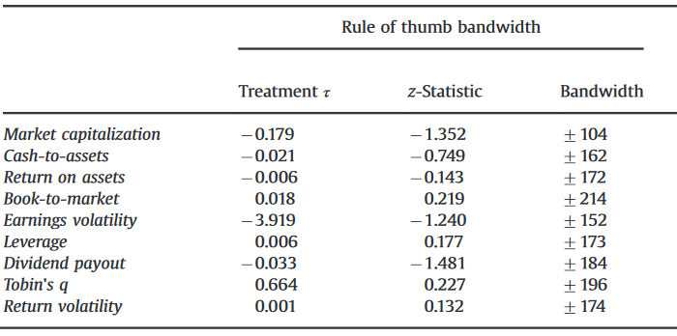
Not that different in company characteristics
Source: Table 2, Panel B

Slide 8
Not that different in company characteristics
Source: Table 2, Panel B

Slide 9
But small difference in market capitalization leads to large difference in index weighting
Russell 2000
Russell 1000
1001-1050
950-1000

Slide 10
But small difference in market capitalization leads to large difference in index weighting
Russell 2000
Russell 1000
1001-1050
950-1000
The smallest 50 companies in the Russell 1000

Slide 11
But small difference in market capitalization leads to large difference in index weighting
Russell 2000
Russell 1000
1001-1050
950-1000
The smallest 50 companies in the Russell 1000
The largest 50 companies in the Russell 2000: a lot higher weighting

Slide 12
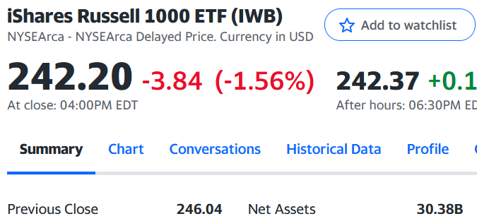
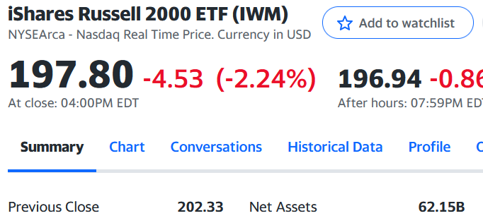
Small difference in assignment leads to large difference in index weighting
Russell 2000
Russell 1000
1001-1050
950-1000
The smallest 50 companies in the Russell 1000
The largest 50 companies in the Russell 2000: a lot higher weighting

Slide 13
Proposed Causal Chain
Management Disclosure
Russell 1000 Inclusion
Institutional Investment
Trading Environment
Analyst Forecasts

Slide 14
Literature Review
Management Disclosure
Russell 1000 Inclusion
Institutional Investment
Trading Environment
Analyst Forecasts
Corporate CSR

Slide 15
Literature Review
Agency conflicts, e.g. monitoring costs
Management Disclosure
Russell 1000 Inclusion
Institutional Investment
Trading Environment
Analyst Forecasts
Corporate CSR

Slide 16
Literature Review
Agency conflicts, e.g. monitoring costs
Management Disclosure
Russell 1000 Inclusion
Institutional Investment
Trading Environment
Analyst Forecasts
Tax planning
Corporate CSR

Slide 17
Problems with the Proposed Causal Chain
Omitted Variables?
Management Disclosure
Russell 1000 Inclusion
Institutional Investment
Trading Environment
Analyst Forecasts
Fuzzy RDD?

Slide 18
Focus of Project
Focus on the direct connection
Management Disclosure
Russell 1000 Inclusion
Institutional Investment
Trading Environment
Analyst Forecasts
Before addressing the whole extent of his conclusions, verify one part of it.

Slide 19
Focus of Project
Management Disclosure
Russell 1000 Inclusion
Institutional Investment
Trading Environment
Analyst Forecasts
Because if this doesn’t hold, the whole story falls apart.

Slide 20
Perturbations and results

Slide 21
Measures
Liquidity Measures (y) | Calculations
Bid-ask spread | (Bid – Ask)/((Bid + Ask)/2)
Turnover | Volume/Shares Outstanding
Dollar volume | Volume x Price
Covariates (x) | Definition
Russell 2000 indicator (treatment) | Is the company in Russell 2000 or Russel 1000?
Weight rank (running variable) | Ranking of company weight in the index centered at the gap between Russell 2000 and 1000. [1] is the smallest company in the Russell 1000. [-1] is the largest in Russell 2000.

Slide 22
Perturbations Attempted
Minor:
Different variable definitions
Running variable
Dependent variable
Major:
Different research design: vary the “bins” according to the graphics

Slide 23
Perturb how the y-variables are calculated
Table: t-statistics for difference-in-means test in [-50,50] bandwidth
 | Original Definition | New
 | Definition 1 | Alt 1 | Alt 2
Bid-ask [1] | -8.76 | -13.52 | -22.58
Turnover [2] | 13.50 | 10.14 | --
Dollar volume [2] | 22.99 | 20.02 | --
[1] Bid-ask spread is calculated as the concurrent bid-ask spread. Alternatively, the 11-month average is calculated. Additionally, the bid-ask spread in cents without price normalization is calculated.
[2] Turnover and dollar volume are calculated originally as the 11-month average of turnover and dollar volume. Alternatively, they are made concurrent.

Slide 24
Perturb how the y-variables are calculated
Table: t-statistics for treatment coefficient in RDD in [-50,50] bandwidth
 | Original Definition | New
 | Definition 1 | Alt 1 | Alt 2
Bid-ask [1] | -9.18 | -7.62 | -14.86
Turnover [2] | 10.05 | 7.34 | --
Dollar volume [2] | 24.5 | 19.5 | --
[1] Bid-ask spread is calculated as the concurrent bid-ask spread. Alternatively, the 11-month average is calculated. Additionally, the bid-ask spread in cents without price normalization is calculated.
[2] Turnover and dollar volume are calculated originally as the 11-month average of turnover and dollar volume. Alternatively, they are made concurrent.

Slide 25
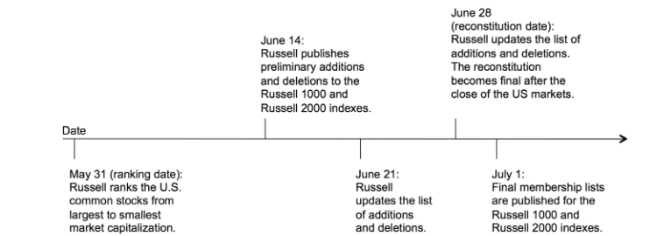
Perturb how the running variable is calculated
Authors report qualitatively similar results.

Slide 26
Perturb how the running variable is calculated
Closer connection to assignment variable.
Authors report qualitatively similar results.

Slide 27
Perturb how the running variable is calculated
Closer connection to institutional holdings
Closer connection to assignment variable.
Authors report qualitatively similar results.

Slide 28
Perturb how running variable is calculated
Table: t-statistics for difference-in-means test in [-50,50] bandwidth
 | June (Actual) Weights | May Weights
Bid-ask | -8.76 | -0.11
Turnover | 13.49 | 0.47
Dollar volume | 22.99 | 2.22

Slide 29
Perturb how running variable is calculated
Table: t-statistics for RDD in [-50,50] bandwidth
 | June (Actual) Weights | May Weights
Bid-ask | -9.19 | 0.7
Turnover | 10.04 | 1.55
Dollar volume | 24.49 | 17.89

Slide 30
Changing the bandwidth
Old bandwidth

Slide 31
Changing the bandwidth
Old bandwidth
New bandwidth
New bandwidth

Slide 32
Changing the bandwidth
Old bandwidth
New bandwidth
New bandwidth
Not establishing a whole new range (or lose the discontinuity). Just use a subset of the bandwidth that the authors use.

Slide 33
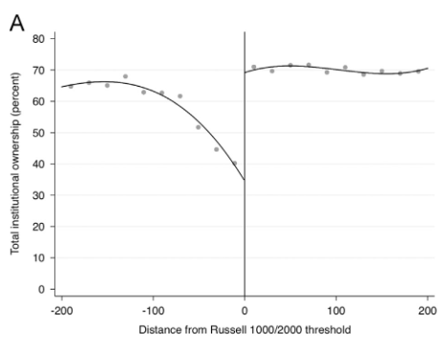
50-100 still shows more institutional ownership
-100 to 50
50 to 100

Slide 34
50-100 still shows more institutional ownership
-100 to 50
50 to 100
Gap in institutional ownership persists across bandwidth

Slide 35
50-100 still shows more institutional ownership
-100 to 50
50 to 100
Gap in institutional ownership persists across bandwidth

Slide 36
Results are inconsistent across new bandwidths for difference-in-mean
Table: t-statistics for difference-in-means test
 | Original |  | New
 | 0-50 | 0-100 | 50-100 | 100-200
Bid-ask | -8.76 | -10.39 | -9.32 | -4.77
Turnover | 13.50 | 10.43 | 0.02 | -0.7
Dollar volume | 22.99 | 12.17 | -7.7 | -25.33
[1] New bandwidths are subsets of old bandwidths
[2] If you restrict the bandwidths to only 50, there’s a severe loss of generalizability which is why the authors chose bandwidths of 200.

Slide 37
Same inconsistency across bandwidth for RDD
Table: t-statistics for treatment coefficient in RDD regression
 | Original |  | New
 | 0-50 | 0-100 | 50-100 | 100-200
Bid-ask | -9.18 | -14.12 | -1.52 | 0.04
Turnover | 10.04 | 13.14 | 0.06 | -3.48
Dollar volume | 24.49 | 29.10 | 0.21 | -1.36
[1] New bandwidths are subsets of old bandwidths
[2] If you restrict the bandwidths to only 50, there’s a severe loss of generalizability which is why the authors chose bandwidths of 200.

Slide 38
Does not change when controlling for market cap
Table: t-statistics for treatment coefficient in RDD regression.
Concurrent market capitalization included as control variable
 | Original |  | New
 | 0-50 | 0-100 | 50-100 | 100-200
Bid-ask | -7.16 | -11.89 | -1.63 | -0.13
Turnover | 10.24 | 13.62 | 0.02 | -3.44
Dollar volume | 16.05 | 20.25 | 0.48 | -1.09
[1] New bandwidths are subsets of old bandwidths
[2] If you restrict the bandwidths to only 50, there’s a severe loss of generalizability which is why the authors chose bandwidths of 200.

Slide 39
Conclusion

Slide 40
Conclusion
Russell 1000 Inclusion
Trading Environment
Motivation: Without this initial connection between inclusion and the trading environment, the entire causal chain would break down.
Results: Perturbing the running variable or the bandwidth parameters causes some statistically significant effects of Russell 1000 inclusion on the trading environment to disappear.

Slide 41
Thank you

